Slide 1
Breadth First Search (BFS)

Slide 2
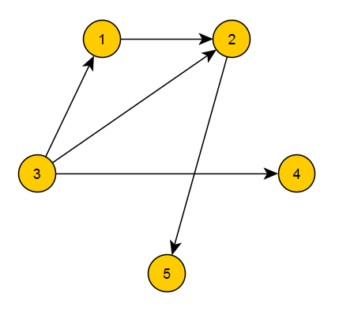
Breadth First Search (BFS)
BFS is also a method to traverse graph.
Algorithm:
BFS(v)
{ add v to queue q
while q is not empty take front vertex u from q
remove front vertex of q
mark u as visited
for all unvisited adjacent vertices w of u
add w to the q
}

Slide 3
Breadth First Search (BFS)
Visited vertices: {} Queue: {}
Current vertex: -
Legend:
Green vertices is unvisited
Gray vertices is queued
Black vertices is visited
Orange vertex is a current vertex
Blue arrows is a path we go
Red arrows is a direction we can’t go
1
2
3
4
5
6
7
8

Slide 4
Breadth First Search (BFS)
Visited vertices: {} Queue: {1}
Current vertex: -
Legend:
Green vertices is unvisited
Gray vertices is queued
Black vertices is visited
Orange vertex is a current vertex
Blue arrows is a path we go
Red arrows is a direction we can’t go
1
2
3
4
5
6
7
8

Slide 5
Breadth First Search (BFS)
Visited vertices: {1} Queue: {}
Current vertex: 1
Legend:
Green vertices is unvisited
Gray vertices is queued
Black vertices is visited
Orange vertex is a current vertex
Blue arrows is a path we go
Red arrows is a direction we can’t go
1
2
3
4
5
6
7
8

Slide 6
Breadth First Search (BFS)
Visited vertices: {1} Queue: {}
Current vertex: 1
Legend:
Green vertices is unvisited
Gray vertices is queued
Black vertices is visited
Orange vertex is a current vertex
Blue arrows is a path we go
Red arrows is a direction we can’t go
1
2
3
4
5
6
7
8

Slide 7
Breadth First Search (BFS)
Visited vertices: {1} Queue: {2, 4}
Current vertex: 1
Legend:
Green vertices is unvisited
Gray vertices is queued
Black vertices is visited
Orange vertex is a current vertex
Blue arrows is a path we go
Red arrows is a direction we can’t go
1
2
3
4
5
6
7
8

Slide 8
Breadth First Search (BFS)
Visited vertices: {1} Queue: {2, 4}
Current vertex: 1
Legend:
Green vertices is unvisited
Gray vertices is queued
Black vertices is visited
Orange vertex is a current vertex
Blue arrows is a path we go
Red arrows is a direction we can’t go
1
2
3
4
5
6
7
8

Slide 9
Breadth First Search (BFS)
Visited vertices: {1} Queue: {2, 4}
Current vertex: -
Legend:
Green vertices is unvisited
Gray vertices is queued
Black vertices is visited
Orange vertex is a current vertex
Blue arrows is a path we go
Red arrows is a direction we can’t go
1
2
3
4
5
6
7
8

Slide 10
Breadth First Search (BFS)
Visited vertices: {1, 2} Queue: {4}
Current vertex: 2
Legend:
Green vertices is unvisited
Gray vertices is queued
Black vertices is visited
Orange vertex is a current vertex
Blue arrows is a path we go
Red arrows is a direction we can’t go
1
2
3
4
5
6
7
8

Slide 11
Breadth First Search (BFS)
Visited vertices: {1, 2} Queue: {4}
Current vertex: 2
Legend:
Green vertices is unvisited
Gray vertices is queued
Black vertices is visited
Orange vertex is a current vertex
Blue arrows is a path we go
Red arrows is a direction we can’t go
1
2
3
4
5
6
7
8

Slide 12
Breadth First Search (BFS)
Visited vertices: {1, 2} Queue: {4, 6, 7}
Current vertex: 2
Legend:
Green vertices is unvisited
Gray vertices is queued
Black vertices is visited
Orange vertex is a current vertex
Blue arrows is a path we go
Red arrows is a direction we can’t go
1
2
3
4
5
6
7
8

Slide 13
Breadth First Search (BFS)
Visited vertices: {1, 2} Queue: {4, 6, 7}
Current vertex: 2
Legend:
Green vertices is unvisited
Gray vertices is queued
Black vertices is visited
Orange vertex is a current vertex
Blue arrows is a path we go
Red arrows is a direction we can’t go
1
2
3
4
5
6
7
8

Slide 14
Breadth First Search (BFS)
Visited vertices: {1, 2} Queue: {4, 6, 7}
Current vertex: -
Legend:
Green vertices is unvisited
Gray vertices is queued
Black vertices is visited
Orange vertex is a current vertex
Blue arrows is a path we go
Red arrows is a direction we can’t go
1
2
3
4
5
6
7
8

Slide 15
Breadth First Search (BFS)
Visited vertices: {1, 2, 4} Queue: {6, 7}
Current vertex: 4
Legend:
Green vertices is unvisited
Gray vertices is queued
Black vertices is visited
Orange vertex is a current vertex
Blue arrows is a path we go
Red arrows is a direction we can’t go
1
2
3
4
5
6
7
8

Slide 16
Breadth First Search (BFS)
Visited vertices: {1, 2, 4} Queue: {6, 7}
Current vertex: 4
Legend:
Green vertices is unvisited
Gray vertices is queued
Black vertices is visited
Orange vertex is a current vertex
Blue arrows is a path we go
Red arrows is a direction we can’t go
1
2
3
4
5
6
7
8

Slide 17
Breadth First Search (BFS)
Visited vertices: {1, 2, 4} Queue: {6, 7, 5}
Current vertex: 4
Legend:
Green vertices is unvisited
Gray vertices is queued
Black vertices is visited
Orange vertex is a current vertex
Blue arrows is a path we go
Red arrows is a direction we can’t go
1
2
3
4
5
6
7
8

Slide 18
Breadth First Search (BFS)
Visited vertices: {1, 2, 4} Queue: {6, 7, 5}
Current vertex: 4
Legend:
Green vertices is unvisited
Gray vertices is queued
Black vertices is visited
Orange vertex is a current vertex
Blue arrows is a path we go
Red arrows is a direction we can’t go
1
2
3
4
5
6
7
8

Slide 19
Breadth First Search (BFS)
Visited vertices: {1, 2, 4} Queue: {6, 7, 5}
Current vertex: -
Legend:
Green vertices is unvisited
Gray vertices is queued
Black vertices is visited
Orange vertex is a current vertex
Blue arrows is a path we go
Red arrows is a direction we can’t go
1
2
3
4
5
6
7
8

Slide 20
Breadth First Search (BFS)
Visited vertices: {1, 2, 4, 6} Queue: {7, 5}
Current vertex: 6
Legend:
Green vertices is unvisited
Gray vertices is queued
Black vertices is visited
Orange vertex is a current vertex
Blue arrows is a path we go
Red arrows is a direction we can’t go
1
2
3
4
5
6
7
8

Slide 21
Breadth First Search (BFS)
Visited vertices: {1, 2, 4, 6} Queue: {7, 5}
Current vertex: 6
Legend:
Green vertices is unvisited
Gray vertices is queued
Black vertices is visited
Orange vertex is a current vertex
Blue arrows is a path we go
Red arrows is a direction we can’t go
1
2
3
4
5
6
7
8

Slide 22
Breadth First Search (BFS)
Visited vertices: {1, 2, 4, 6} Queue: {7, 5}
Current vertex: 6
Legend:
Green vertices is unvisited
Gray vertices is queued
Black vertices is visited
Orange vertex is a current vertex
Blue arrows is a path we go
Red arrows is a direction we can’t go
1
2
3
4
5
6
7
8

Slide 23
Breadth First Search (BFS)
Visited vertices: {1, 2, 4, 6} Queue: {7, 5}
Current vertex: -
Legend:
Green vertices is unvisited
Gray vertices is queued
Black vertices is visited
Orange vertex is a current vertex
Blue arrows is a path we go
Red arrows is a direction we can’t go
1
2
3
4
5
6
7
8

Slide 24
Breadth First Search (BFS)
Visited vertices: {1, 2, 4, 6, 7} Queue: {5}
Current vertex: 7
Legend:
Green vertices is unvisited
Gray vertices is queued
Black vertices is visited
Orange vertex is a current vertex
Blue arrows is a path we go
Red arrows is a direction we can’t go
1
2
3
4
5
6
7
8

Slide 25
Breadth First Search (BFS)
Visited vertices: {1, 2, 4, 6, 7} Queue: {5}
Current vertex: 7
Legend:
Green vertices is unvisited
Gray vertices is queued
Black vertices is visited
Orange vertex is a current vertex
Blue arrows is a path we go
Red arrows is a direction we can’t go
1
2
3
4
5
6
7
8

Slide 26
Breadth First Search (BFS)
Visited vertices: {1, 2, 4, 6, 7} Queue: {5, 3}
Current vertex: 7
Legend:
Green vertices is unvisited
Gray vertices is queued
Black vertices is visited
Orange vertex is a current vertex
Blue arrows is a path we go
Red arrows is a direction we can’t go
1
2
3
4
5
6
7
8

Slide 27
Breadth First Search (BFS)
Visited vertices: {1, 2, 4, 6, 7} Queue: {5, 3}
Current vertex: 7
Legend:
Green vertices is unvisited
Gray vertices is queued
Black vertices is visited
Orange vertex is a current vertex
Blue arrows is a path we go
Red arrows is a direction we can’t go
1
2
3
4
5
6
7
8

Slide 28
Breadth First Search (BFS)
Visited vertices: {1, 2, 4, 6, 7} Queue: {5, 3}
Current vertex: -
Legend:
Green vertices is unvisited
Gray vertices is queued
Black vertices is visited
Orange vertex is a current vertex
Blue arrows is a path we go
Red arrows is a direction we can’t go
1
2
3
4
5
6
7
8

Slide 29
Breadth First Search (BFS)
Visited vertices: {1, 2, 4, 6, 7, 5} Queue: {3}
Current vertex: 5
Legend:
Green vertices is unvisited
Gray vertices is queued
Black vertices is visited
Orange vertex is a current vertex
Blue arrows is a path we go
Red arrows is a direction we can’t go
1
2
3
4
5
6
7
8

Slide 30
Breadth First Search (BFS)
Visited vertices: {1, 2, 4, 6, 7, 5} Queue: {3}
Current vertex: 5
Legend:
Green vertices is unvisited
Gray vertices is queued
Black vertices is visited
Orange vertex is a current vertex
Blue arrows is a path we go
Red arrows is a direction we can’t go
1
2
3
4
5
6
7
8

Slide 31
Breadth First Search (BFS)
Visited vertices: {1, 2, 4, 6, 7, 5} Queue: {3, 8}
Current vertex: 5
Legend:
Green vertices is unvisited
Gray vertices is queued
Black vertices is visited
Orange vertex is a current vertex
Blue arrows is a path we go
Red arrows is a direction we can’t go
1
2
3
4
5
6
7
8

Slide 32
Breadth First Search (BFS)
Visited vertices: {1, 2, 4, 6, 7, 5} Queue: {3, 8}
Current vertex: 5
Legend:
Green vertices is unvisited
Gray vertices is queued
Black vertices is visited
Orange vertex is a current vertex
Blue arrows is a path we go
Red arrows is a direction we can’t go
1
2
3
4
5
6
7
8

Slide 33
Breadth First Search (BFS)
Visited vertices: {1, 2, 4, 6, 7, 5} Queue: {3, 8}
Current vertex: -
Legend:
Green vertices is unvisited
Gray vertices is queued
Black vertices is visited
Orange vertex is a current vertex
Blue arrows is a path we go
Red arrows is a direction we can’t go
1
2
3
4
5
6
7
8

Slide 34
Breadth First Search (BFS)
Visited vertices: {1, 2, 4, 6, 7, 5, 3} Queue: {8}
Current vertex: 3
Legend:
Green vertices is unvisited
Gray vertices is queued
Black vertices is visited
Orange vertex is a current vertex
Blue arrows is a path we go
Red arrows is a direction we can’t go
1
2
3
4
5
6
7
8

Slide 35
Breadth First Search (BFS)
Visited vertices: {1, 2, 4, 6, 7, 5, 3} Queue: {8}
Current vertex: 3
Legend:
Green vertices is unvisited
Gray vertices is queued
Black vertices is visited
Orange vertex is a current vertex
Blue arrows is a path we go
Red arrows is a direction we can’t go
1
2
3
4
5
6
7
8

Slide 36
Breadth First Search (BFS)
Visited vertices: {1, 2, 4, 6, 7, 5, 3} Queue: {8}
Current vertex: 3
Legend:
Green vertices is unvisited
Gray vertices is queued
Black vertices is visited
Orange vertex is a current vertex
Blue arrows is a path we go
Red arrows is a direction we can’t go
1
2
3
4
5
6
7
8

Slide 37
Breadth First Search (BFS)
Visited vertices: {1, 2, 4, 6, 7, 5, 3} Queue: {8}
Current vertex: -
Legend:
Green vertices is unvisited
Gray vertices is queued
Black vertices is visited
Orange vertex is a current vertex
Blue arrows is a path we go
Red arrows is a direction we can’t go
1
2
3
4
5
6
7
8

Slide 38
Breadth First Search (BFS)
Visited vertices: {1, 2, 4, 6, 7, 5, 3, 8} Queue: {}
Current vertex: 8
Legend:
Green vertices is unvisited
Gray vertices is queued
Black vertices is visited
Orange vertex is a current vertex
Blue arrows is a path we go
Red arrows is a direction we can’t go
1
2
3
4
5
6
7
8

Slide 39
Breadth First Search (BFS)
Visited vertices: {1, 2, 4, 6, 7, 5, 3, 8} Queue: {}
Current vertex: 8
Legend:
Green vertices is unvisited
Gray vertices is queued
Black vertices is visited
Orange vertex is a current vertex
Blue arrows is a path we go
Red arrows is a direction we can’t go
1
2
3
4
5
6
7
8

Slide 40
Breadth First Search (BFS)
Visited vertices: {1, 2, 4, 6, 7, 5, 3, 8} Queue: {}
Current vertex: 8
Legend:
Green vertices is unvisited
Gray vertices is queued
Black vertices is visited
Orange vertex is a current vertex
Blue arrows is a path we go
Red arrows is a direction we can’t go
1
2
3
4
5
6
7
8

Slide 41
Breadth First Search (BFS)
Visited vertices: {1, 2, 4, 6, 7, 5, 3, 8} Queue: {}
Current vertex: -
Legend:
Green vertices is unvisited
Gray vertices is queued
Black vertices is visited
Orange vertex is a current vertex
Blue arrows is a path we go
Red arrows is a direction we can’t go
1
2
3
4
5
6
7
8

Slide 42
Breadth First Search (BFS)
Visited vertices: {1, 2, 4, 6, 7, 5, 3, 8} Queue: {}
Current vertex: -
Legend:
Green vertices is unvisited
Gray vertices is queued
Black vertices is visited
Orange vertex is a current vertex
Blue arrows is a path we go
Red arrows is a direction we can’t go
1
2
3
4
5
6
7
8

Slide 43
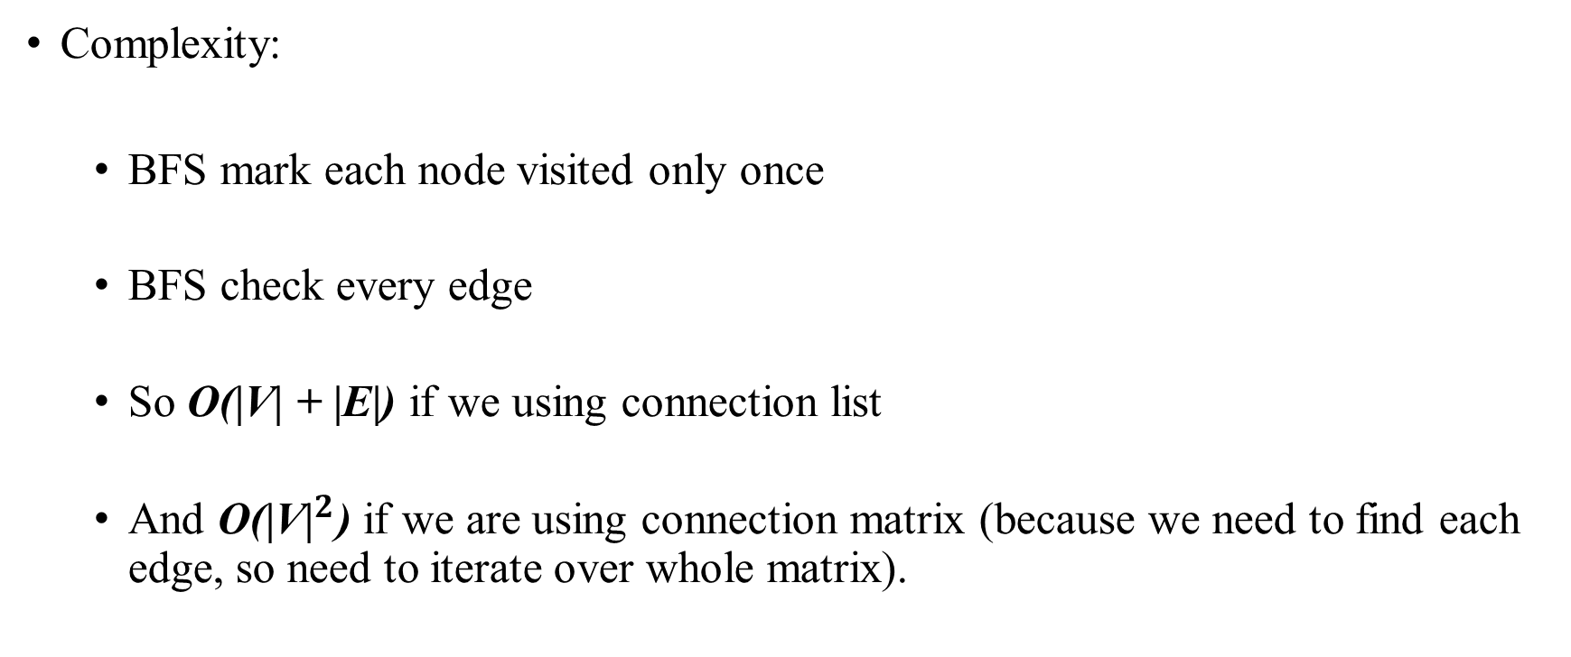
Breadth First Search (BFS)
Complexity:
BFS mark each node visited only once
BFS check every edge
So O(|V| + |E|) if we using connection list
And O(${\text{|}\text{V}\text{|}}^{2}$) if we are using connection matrix (because we need to find each edge, so need to iterate over whole matrix).

Slide 44
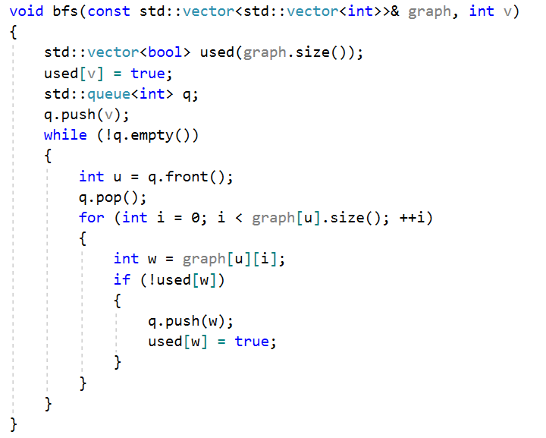
Breadth First Search (BFS)
Code in C++ using connection list

Slide 45
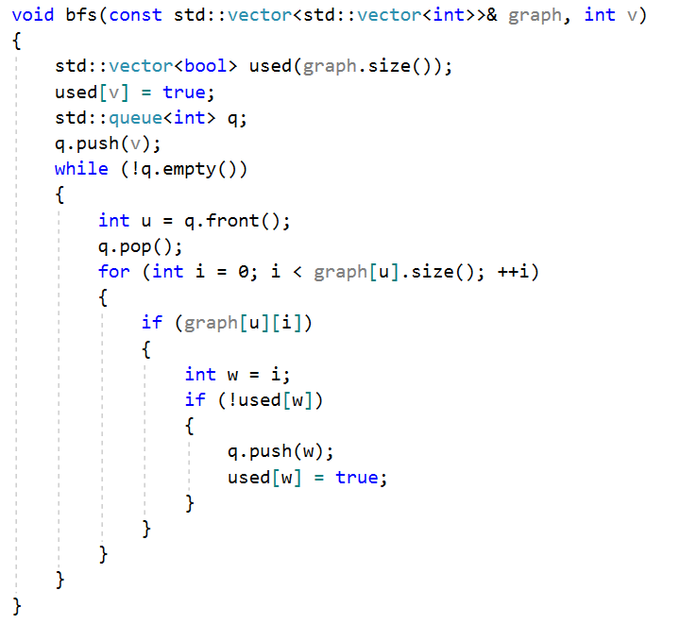
Breadth First Search (BFS)
Code in C++ using connection matrix

